Slide 1
Objectives
In this session, you will learn to:
  Understand the accounting principles and concepts
  Understand the double entry system of accounts
Notes:
Share the session objectives with the students.

Slide 2
Understanding the Accounting Principles and Concepts
Accounting is the art of recording, classifying, and summarizing transactions and events in terms of money, in a significant manner and interpreting the results thereof.
It is a finance support system that helps to:
  Record activities.
  Classify transactions and events.
  Monitor financial performance.
  Ascertain the result of business activities.
  Arrive at the financial position of the organization.
Notes:
Share the session objectives with the students.

Slide 3
Understanding the Accounting Principles and Concepts (Contd.)
The main objective of accounting is to:
  Ascertain the result of business activities during a year.
  Show the financial position of a business on a particular date.
The financial status of an organization, as on a particular date, is captured in the balance sheet.
The financial performance of an organization, as on a particular date, is captured in a profit and loss statement.
Notes:
Share the session objectives with the students.

Slide 4
Understanding the Accounting Principles and Concepts (Contd.)
Accounting has the following branches:
  Financial accounting:
    Ascertains the profit and financial position of the business.
  Cost accounting:
    Ascertains the cost of goods produced or services rendered by a business.
  Management accounting:
    Supplies relevant information at the appropriate time to the management to enable decision-making and exercise effective control.
Notes:
Share the session objectives with the students.

Slide 5
Understanding the Accounting Principles and Concepts (Contd.)
Transactions:
  Are events or happenings that change an organization's financial position and/or its earnings.
  Can be classified as:
    Receipts
    Payments
    Purchases
    Sales
Recording transactions:
  Is an essential activity to ascertain the financial status of a company as on a particular date.
Notes:
Share the session objectives with the students.

Slide 6
Understanding the Accounting Principles and Concepts (Contd.)
Recording transactions:
  Is an essential activity to ascertain the financial status of a company as on a particular date.
The usual transactions of a business are:
  Purchase of goods either as raw material for further processing, or as finished goods for resale.
  Payment of expenses incurred towards business.
  Sale of goods or services.
  Receipts, in cash or cheque.
  Other payments, by cash or cheque.
Notes:
Share the session objectives with the students.

Slide 7
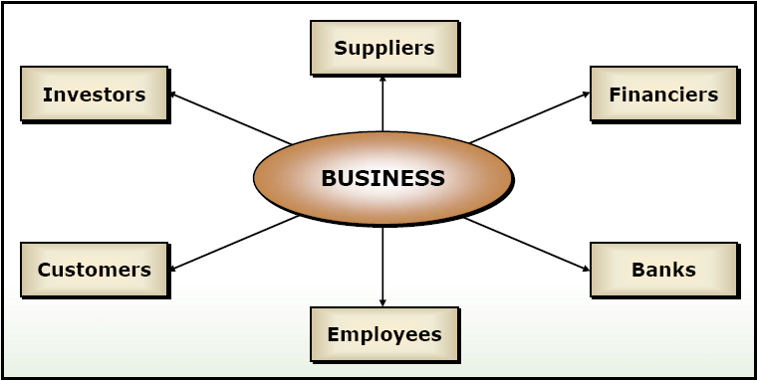
Understanding the Accounting Principles and Concepts (Contd.)
The following figure shows the parties dealt within a business process.
Notes:
Share the session objectives with the students.

Slide 8
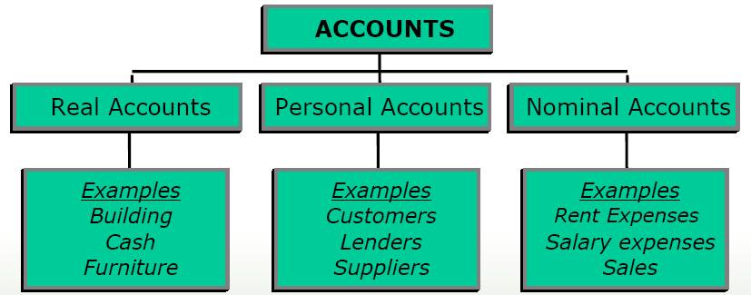
Understanding the Accounting Principles and Concepts (Contd.)
The following figure shows the types of accounts.
Notes:
Share the session objectives with the students.

Slide 9
Understanding the Accounting Principles and Concepts (Contd.)
Accounts can be broadly classified under the following five groups:
  Assets: Valuable things owned by a business that can be expressed in monetary terms.
  Liabilities: The obligations or debts payable by a business in future in the form of money or goods.
  Capital: Cash-in-hand, cash-at-hand, building, plant, and furniture are all part of a company’s wealth or capital that is used for further assumption.
  Revenue: The amount realized or receivable from the sale of goods.
  Expenses: The cost incurred by the business in the process of earning revenues.
Notes:
Share the session objectives with the students.

Slide 10
Understanding the Accounting Principles and Concepts (Contd.)
Accounting Concepts: Are the assumptions on which accounting is based.
Some of the important accounting concepts are:
  Money Measurement Concept
  Accounting Period Concept
  Accrual Concept
  Business Entity Concept
  Going Concern Concept
  Matching Concept
  Dual-Aspect Concept
  Realisation Concept
Notes:
Share the session objectives with the students.

Slide 11
Understanding the Accounting Principles and Concepts (Contd.)
Money Measurement Concept states that:
  Only those transactions and events are recorded in accounting which can be expressed in monetary terms.
Accounting Period Concept states that:
  The users of the financial statements need periodical reporting to performance of the business.
Accrual Concept states that:
  Expenses and revenues incurred for a particular accounting period should reckoned in the same period, irrespective of the fact whether these expenses had been paid in cash or not in that year.
Business Entity Concept states that:
  An accounting entity is hold to be “separate and distinct from it’s owner”.
Notes:
Share the session objectives with the students.

Slide 12
Understanding the Accounting Principles and Concepts (Contd.)
Going Concern Concept states that:
  It is assumed that the business will exist for an indefinite period of time and transactions are recorded from this point of view.
Matching Concept states that:
  Revenues as well as expenses are to be estimated for an accounting period irrespective of actual receipt of cash.
Dual-Aspect Concept states that:
  Every transaction entered into by a firm will have two aspects.
Realisation Concept states that:
  Revenue should be measured in the period in which it is earned or realized.
Notes:
Share the session objectives with the students.

Slide 13
Understanding the Accounting Principles and Concepts (Contd.)
Accounting Conventions:
  Refers to the customs or traditions used to bring about uniformity in the maintenance of accounts.
Some of the important accounting conventions are:
  Convention of Consistency
  Convention of Conservatism
  Convention of Disclosure
  Convention of Materiality
Notes:
Share the session objectives with the students.

Slide 14
Understanding the Accounting Principles and Concepts (Contd.)
Convention of Consistency states that:
  Organizations must follow consistent accounting practices and policies over various accounting periods.
Convention of Conservatism states that:
  It is essential that the valuation of the financial transactions as reflected in the financial statements is done conservatively.
Convention of Disclosure states that:
  Financial statements must be free from subjective bias and they should be made available early enough to enable users to take timely decisions.
Convention of Materiality states that:
  Immaterial transactions should be clubbed under appropriate heads.
Notes:
Share the session objectives with the students.

Slide 15
Understanding Double Entry System of Accounts
Double Entry System:
  Is a system of recording transactions in a manner that maintains the equality of the accounting equation.
  Allows to record each transaction as a debit and a credit, where every debit has a corresponding credit and vice versa.
Notes:
Share the session objectives with the students.

Slide 16
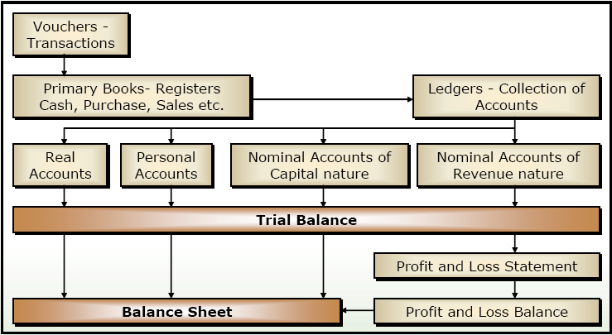
Understanding Double Entry System of Accounts (Contd.)
The following figure shows the double entry system.
Notes:
Share the session objectives with the students.

Slide 17
Understanding Double Entry System of Accounts (Contd.)
    The following table displays the rules of debit and credit for real, personal, and nominal accounts.
 | Real Accounts | Personal Accounts | Nominal Accounts
Debit | What comes in | The Receiver | Expenses and Losses
Credit | What goes out | The Giver | Incomes and Gains

Slide 18
Understanding Double Entry System of Accounts (Contd.)
Journal:
  Is a book in which business transactions are entered in chronological order.
  Records a single transaction as a journal entry.
  Supports the journal entry by a voucher evidencing the related transaction.
Voucher:
  Is a document containing the details of a financial transaction.
Notes:
Share the session objectives with the students.

Slide 19
Understanding Double Entry System of Accounts (Contd.)
Posting:
  Is a process by which information about transactions is transferred or moved to an account.
Accounting period:
  Is a regular period of time such as a quarter or a year for which a financial statement is generated.
Notes:
Share the session objectives with the students.

Slide 20
Summary
In this session, you learned that:
  Accounting is the art of recording, classifying, and summarizing transactions and events in terms of money, in a significant manner and interpreting the results thereof.
  The financial status of an organization, as on a particular date, is captured in the balance sheet.
  The financial performance of an organization, as on a particular date, is captured in a profit and loss statement.
  There are three branches of accounting:
    Financial accounting
    Cost accounting
    Management accounting

Slide 21
Summary (Contd.)
  Transactions are the events or happenings that change an organization's financial position and/or its earnings.
  Recording transactions Is an essential activity to ascertain the financial status of a company as on a particular date.
  Accounts can be broadly divided into the following five groups:
    Assets
    Liabilities
    Capital
    Revenue
    Expenses
  Accounting concepts are the assumptions on which accounting is based.
  Accounting conventions refers to the customs or traditions used to bring about uniformity in the maintenance of accounts.

Slide 22
Summary (Contd.)
  Double entry system is a system of recording transactions in a manner that maintains the equality of the accounting equation.
  Journal is a book in which business transactions are entered in chronological order.
  Voucher is a document containing the details of a financial transaction.
  Posting is the process by which information about transactions is transferred or moved, to an account.
  Accounting period is a regular period of time, such as a quarter or a year, for which a financial statement is generated.

